Slide 1
Welcome
To my presentation

Slide 2
AGENDA
What I have learn in website?
What is my problem & solution?
Why my website is great?

Slide 3
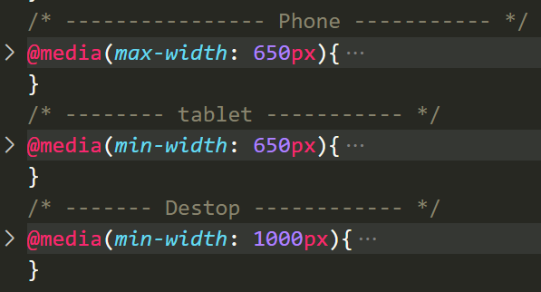
I have learn from my website
How to responsive website property on Desk top, Tablet, Phone
How to chose font family and icon property
How to chose the color property
How to identify Component and Grid
Muck up before do website

Slide 4
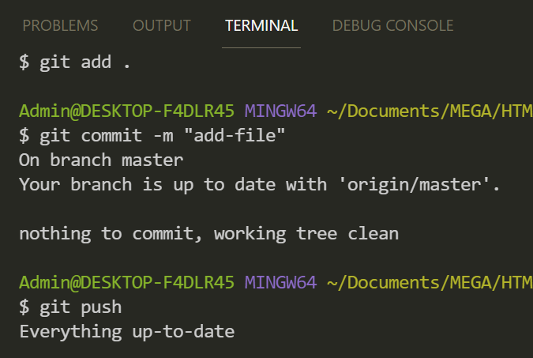
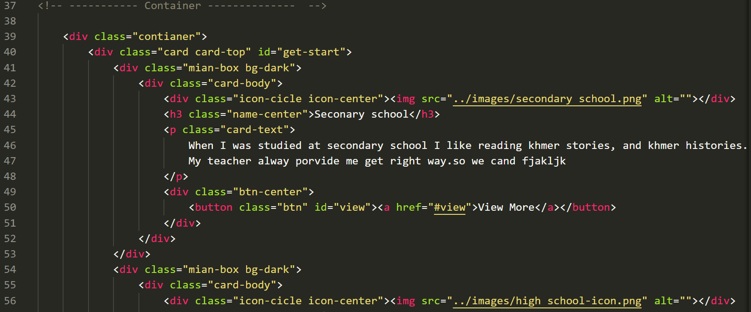
My Problem and Solution
Difficult for responsive on size screen device.
Practice, Researching about responsive on device.
Not well for coding. Try to do and check it again and again.
Text descriptions
Chosen font family and icon property
Command adding to GitHub

Slide 5
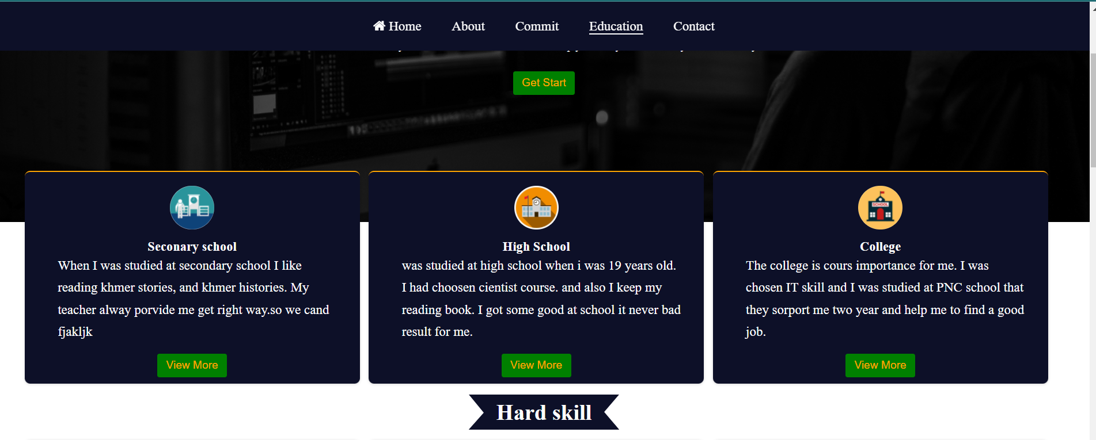
My website great
I done muck up website with grid and got more advice from teacher
Chose the good color , font family and font size
Check each other website
Learn form mistake and correct it
A lot of practice with coding
Like Good

Slide 6
Thank You!

